Slide 1
Acoustic levitation using a TinyLev acoustic levitator
Final Report
Dalton Ludington
Daniel Opdahl

Slide 2
Goal
To determine what the largest specific weight of an object of set volume that can be levitated is?
Notes:
The definition of specific weight is an object’s weight on Earth per unit volume of material
Our Testable research question™ is “What is the largest specific weight of an object of set volume that can be levitated?”

Slide 3
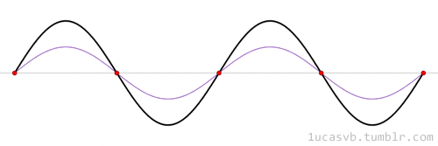
Standing wave review
1ucasvb’s lab. “Standing waves (aka stationary waves)” 19 Mar 2013, 20:40, https://1ucasvb.tumblr.com/post/45792819532/standing-waves-aka-stationary-waves-standing#notes
Notes:
Wave is made of high and low pressure that travels through air.
Areas of pressure correspond to displacement of air molecules from original position
2 waves can combine to constructively or destructively interfere
Standing waves are the real kicker for our theory
2 waves, red and blue, combine to the solid black wave
Note how in a standing wave the location of peak displacements don’t move through space
Red dots are nodes, and in between the red dots are antinodes
Nodes = low displacement, high pressure
Antinodes =oscillate between high and low pressure

Slide 4
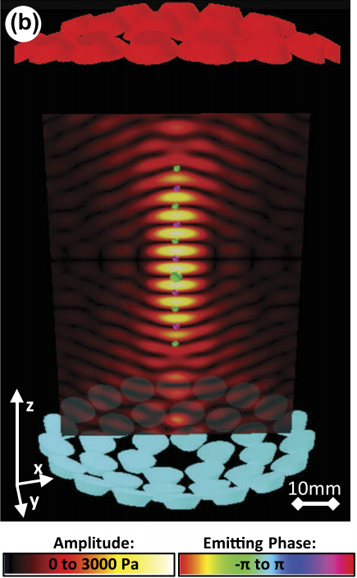
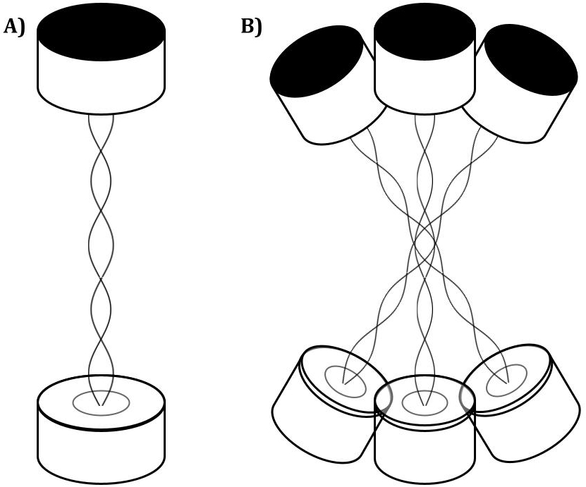
Acoustic levitation
TinyLev: A multi-emitter single-axis acoustic levitator. Asier Marzo, August 10, 2017. https://aip.scitation.org/doi/pdf/10.1063/1.4989995
Notes:
We place transducers in opposing pairs that create standing waves, as in A
If many pairs of opposing transistors are arranged in a crescent or bowl shape, the center nodes created by each standing wave are all superimposed on one another.
This creates a focused central node, formed by the combination of all of the standing waves, as well as several nodes above and below the central node.
This is a more realistic model of the diagram before
Opposing transistors arranged in bowl shapes create many standing waves that combine to create several nodes (dark bands corresponding to small amplitudes) and antinodes (bright bands corresponding to large amplitudes). Objects (green and purple spheres) can be levitated in the nodes of the standing waves.

Slide 5
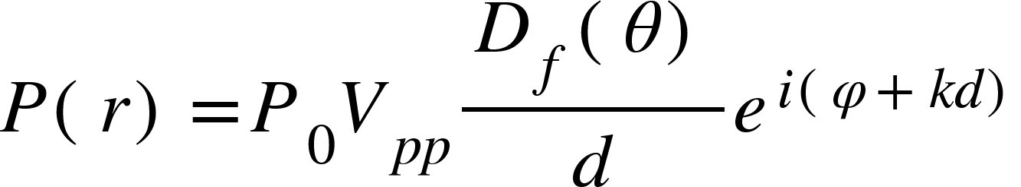
Determining the Pressure
Far-field directivity function
Locating vector
Amplitude constant
Propagation distance
Wavenumber
Peak-to-peak amplitude
Emitting phase of source
TinyLev: A multi-emitter single-axis acoustic levitator (Additional Resources). Asier Marzo, August 10, 2017. https://aip.scitation.org/doi/pdf/10.1063/1.4989995
Notes:
In order to determine the largest specific weight of leviated object, we will be working with a model that relates the pressure to the force
For our purposes, at least initially, we want to focus on the central node for simplicity.
The equation above gives the pressure as a function of a locating vector r for a single transducer
This equation incorporates the voltage applied to the transducers, etc.
D(0) can be modeled as sinc = sinx/x

Slide 6
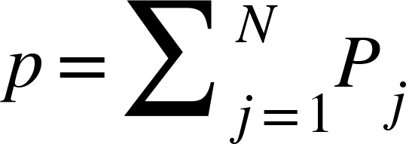
Summing the Pressures
Number of individual transducers (for us, N=72)
Total acoustic field
Individual acoustic field
TinyLev: A multi-emitter single-axis acoustic levitator (Additional Resources). Asier Marzo, August 10, 2017. https://aip.scitation.org/doi/pdf/10.1063/1.4989995
Notes:
We will get the total acoustic field generated by all the transducers by simply summing the individual fields

Slide 7
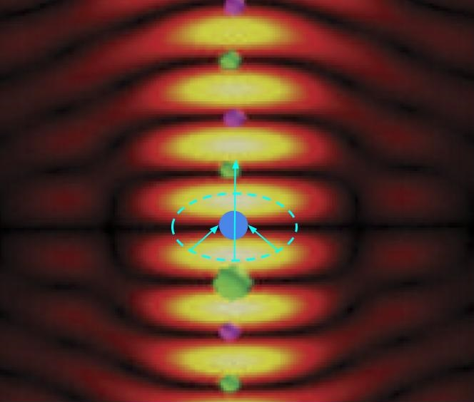

Determining the Force
Force
Gork’ov potential
TinyLev: A multi-emitter single-axis acoustic levitator. Asier Marzo, August 10, 2017. https://aip.scitation.org/doi/pdf/10.1063/1.4989995
Notes:
Gorkov potential
In 1961, L.P Gor’kov derived the lowest order force on a spherical particle in an acoustic field.

Slide 8
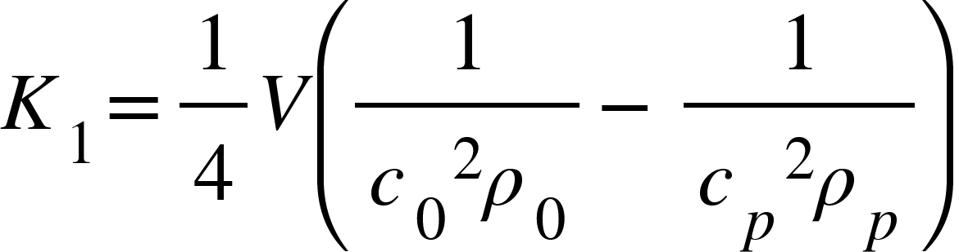
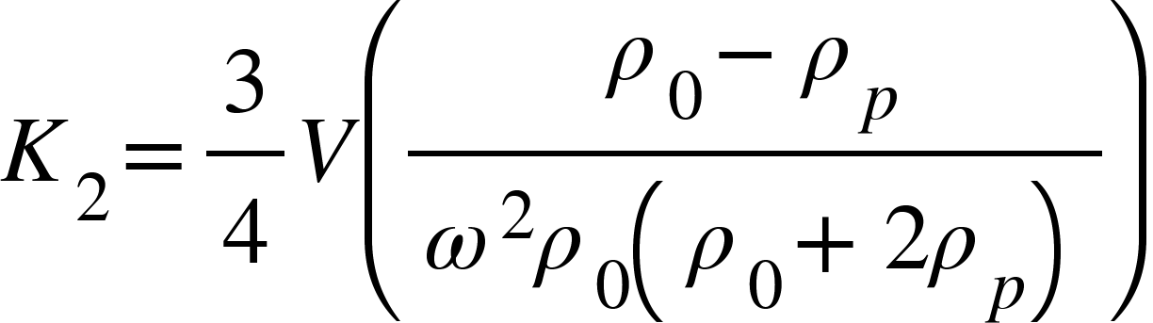
Gork’ov Potential
TinyLev: A multi-emitter single-axis acoustic levitator (Additional Resources). Asier Marzo, August 10, 2017. https://aip.scitation.org/doi/pdf/10.1063/1.4989995
Complex pressure
Partial derivatives of complex pressure
Volume of levitated particle
Speed of sound through levitated particle
Speed of sound in air
Density of air
Density of particle
Notes:
We are writing matlab code to calculate these
We think that this is appropriate to answer our question because it allows us to calculate and model a complex pressure field from just the voltage applied, and a few constants that depend on our particular set up (transducers, air, etc.) and from that pressure field, we can get our force, which will allow us to say what the largest specific weight of a set volume we can levitate.

Slide 9
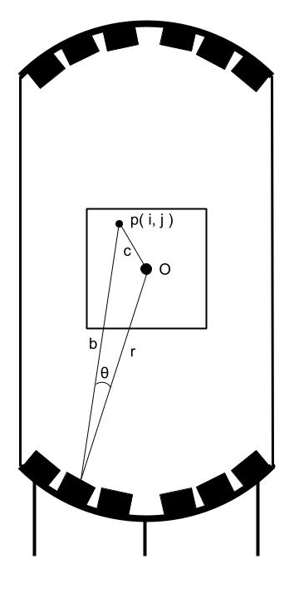
MATLAB analysis
Revised analysis
Script from Dr. Marzo
Reduction to 2D grid
Notes:
Use MATLAB to simplify to 2 dimensions, get distance b to point of interest and angle theta to generate far field directivity function, and calculate pressure at every point.

Slide 10
Why This Model?
Notes:
This model is appropriate because it allows us to find how much levitating force is being exerted on an object. When that levitating force and the gravitational force balance, we can find the largest specific weight of a levitating object.

Slide 11
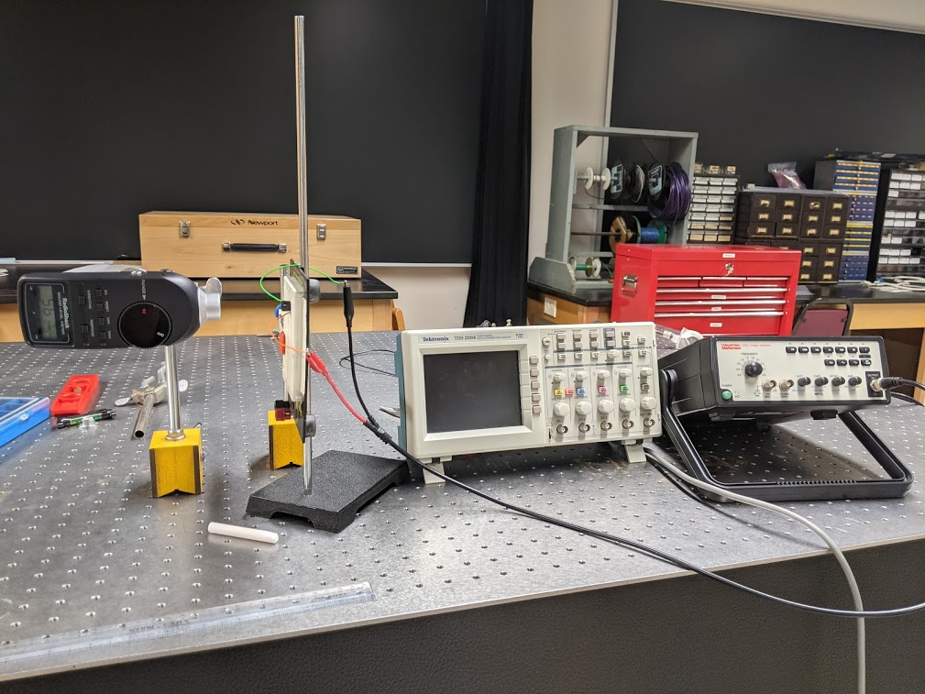
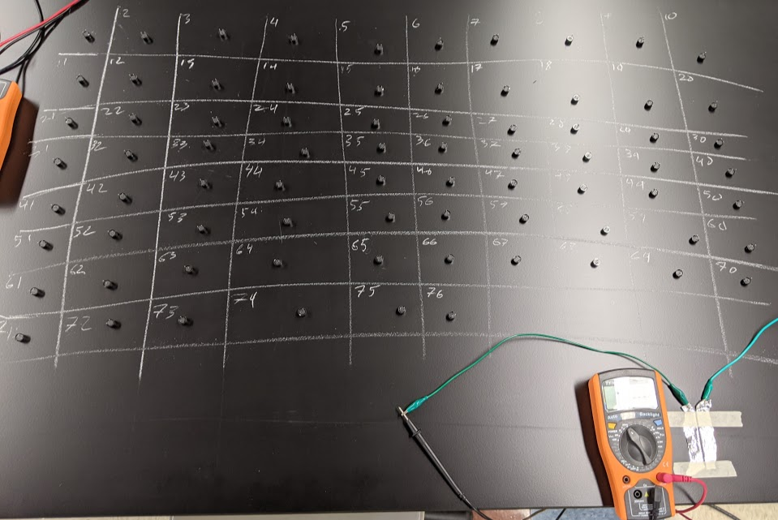
Transducer testing

Slide 12
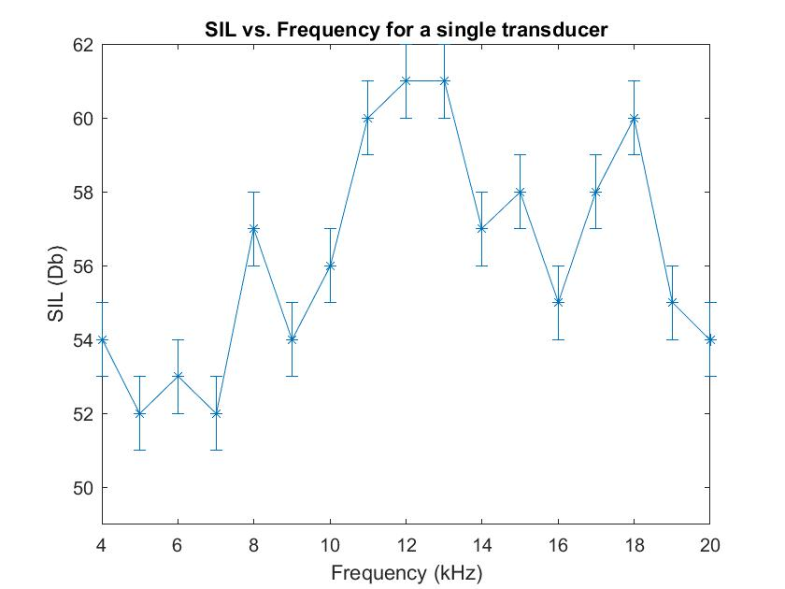
Assumption testing

Slide 13
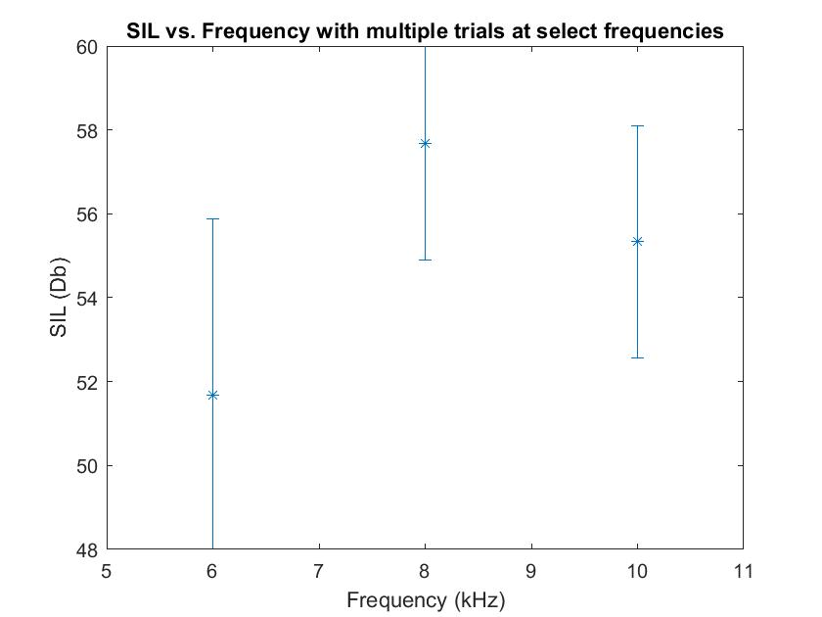
Assumption testing

Slide 14
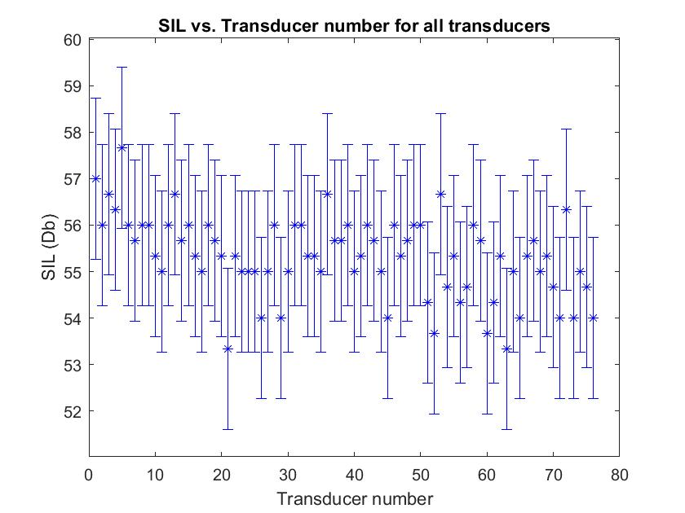
Transducer testing

Slide 15
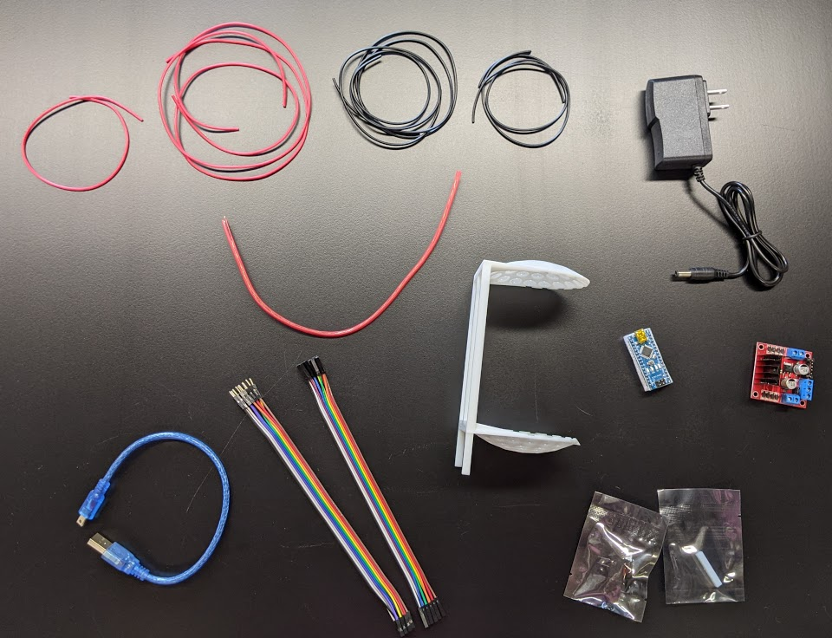
Levitator components

Slide 16
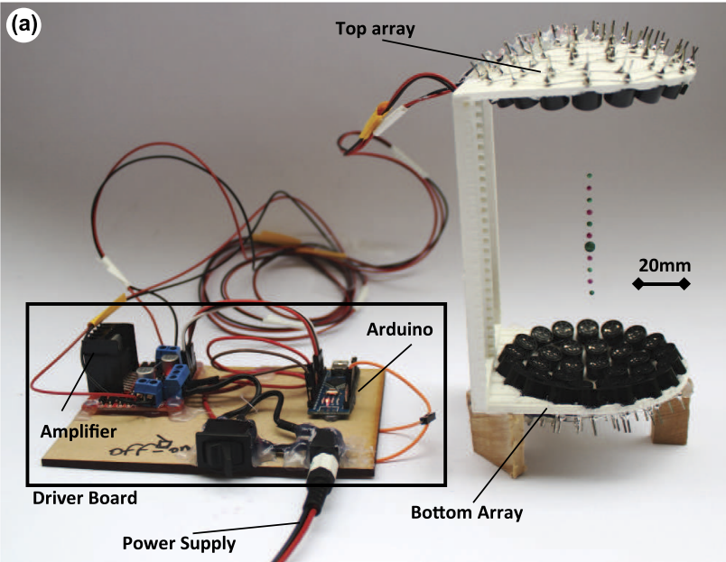
Whole levitator apparatus
TinyLev: A multi-emitter single-axis acoustic levitator. Asier Marzo, August 10, 2017. https://aip.scitation.org/doi/pdf/10.1063/1.4989995

Slide 17
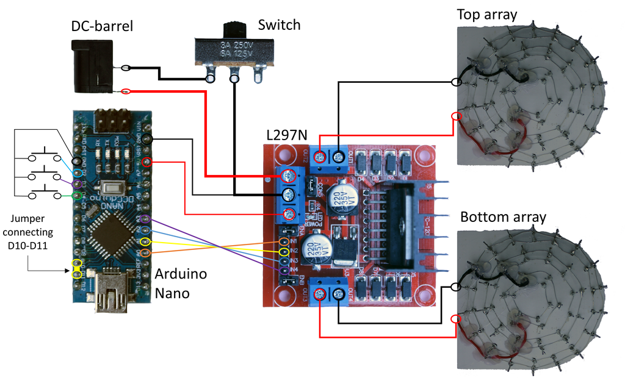
Levitator apparatus schematic
Acoustic Levitator. UpnaLab. Instructables. August 14, 2017. https://www.instructables.com/Acoustic-Levitator/
Notes:
Daniel: Talk about how the apparatus will help us to determine the specific weight of a levitating object

Slide 18
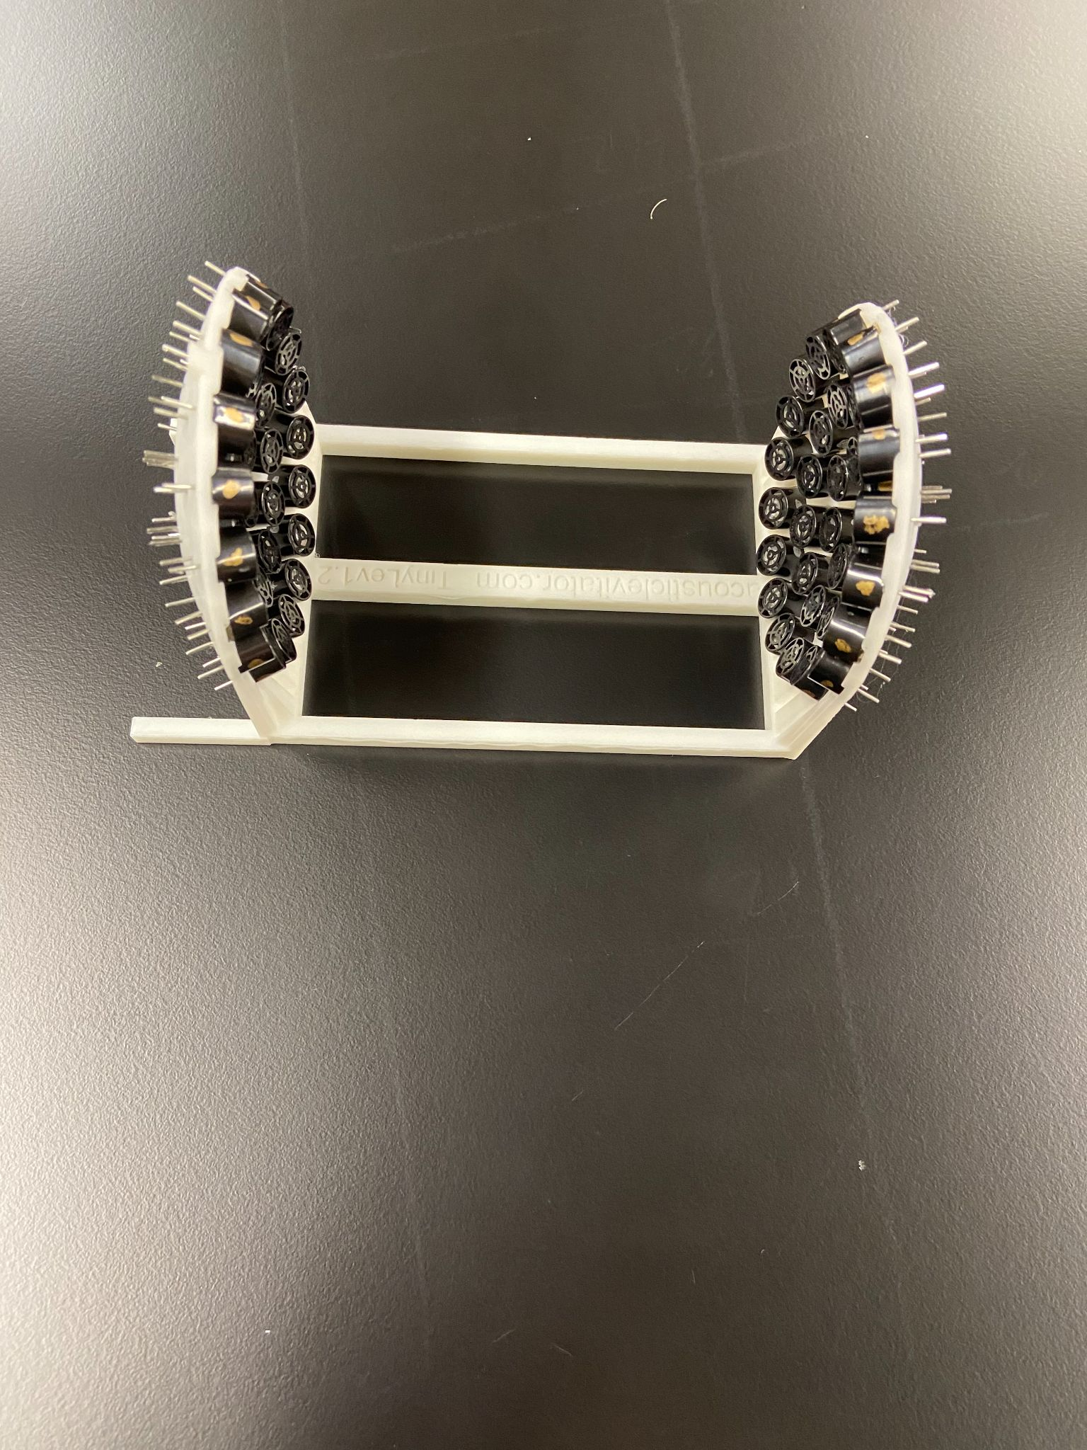
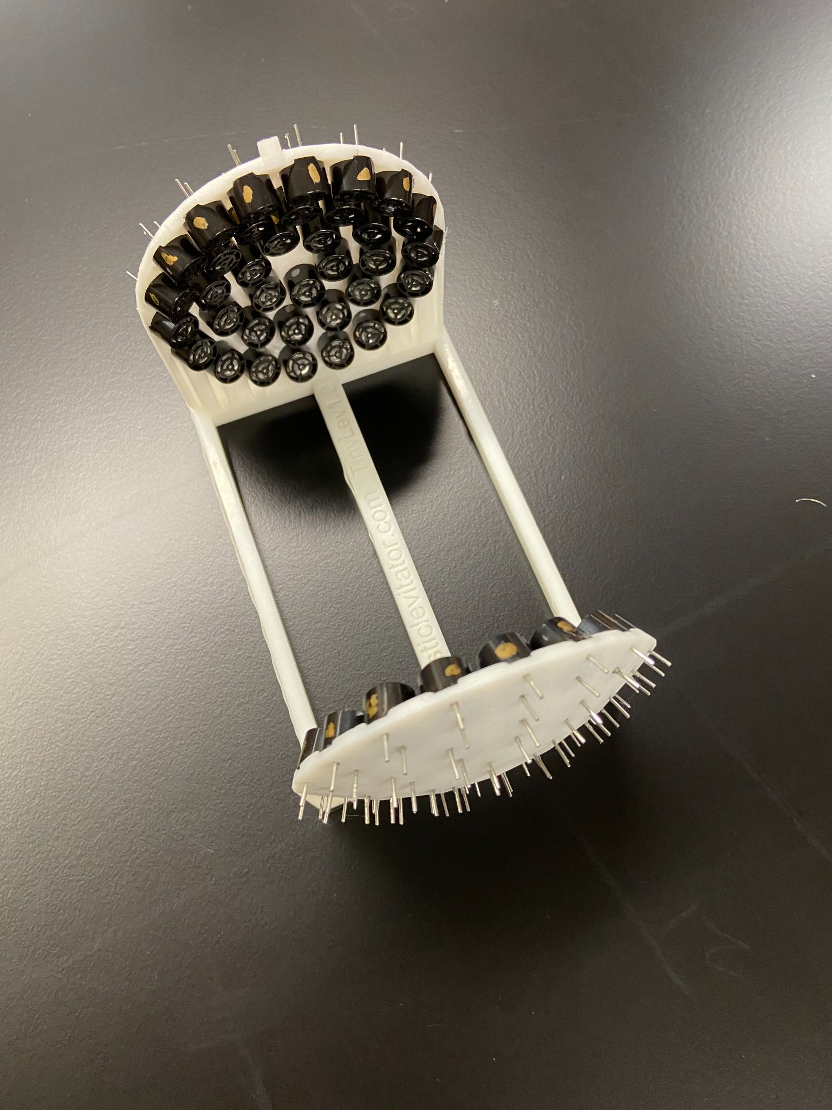
Construction

Slide 19
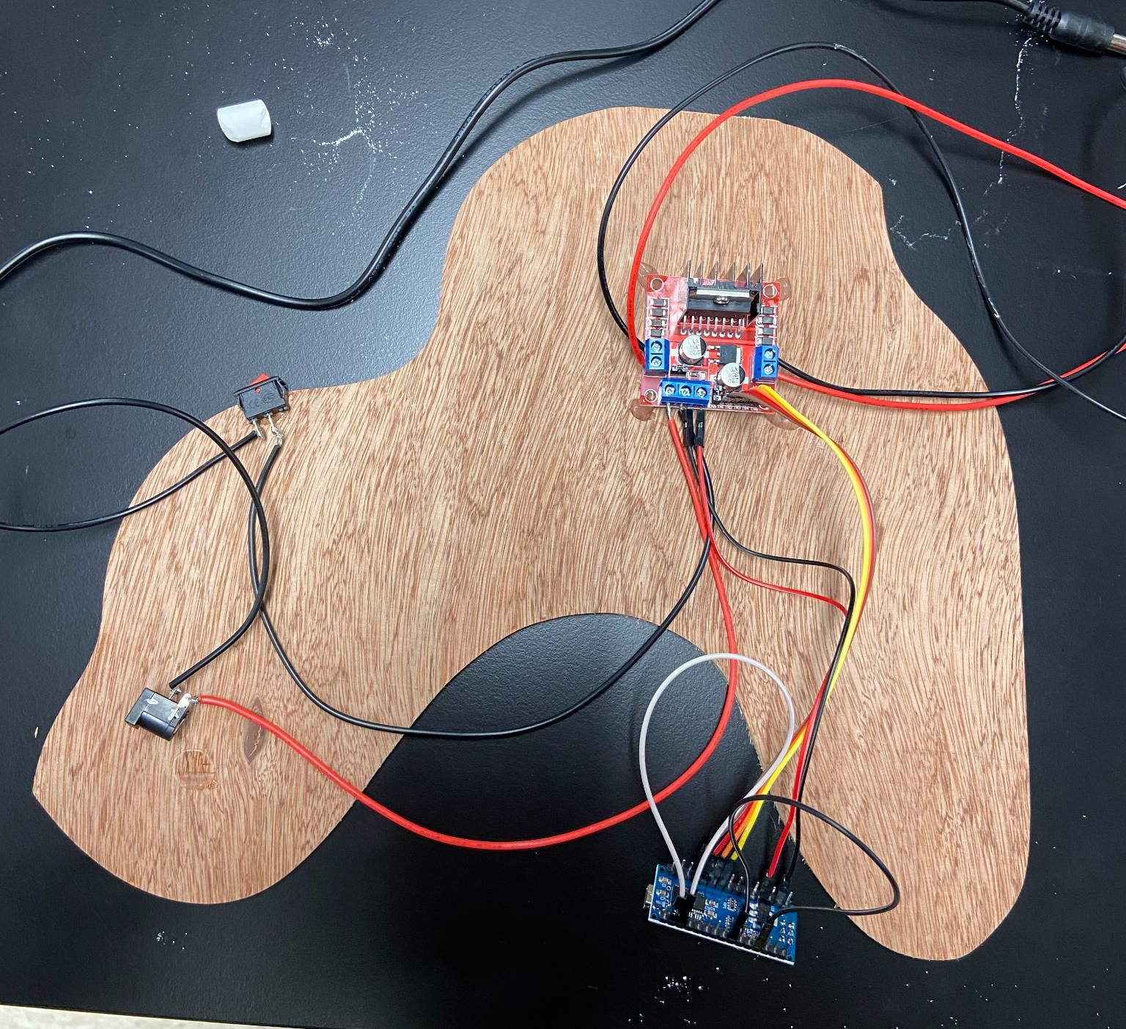
Construction

Slide 20
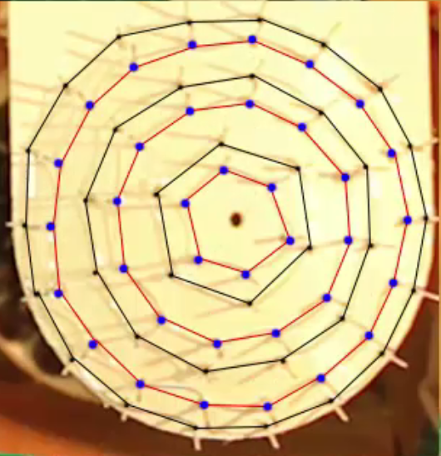
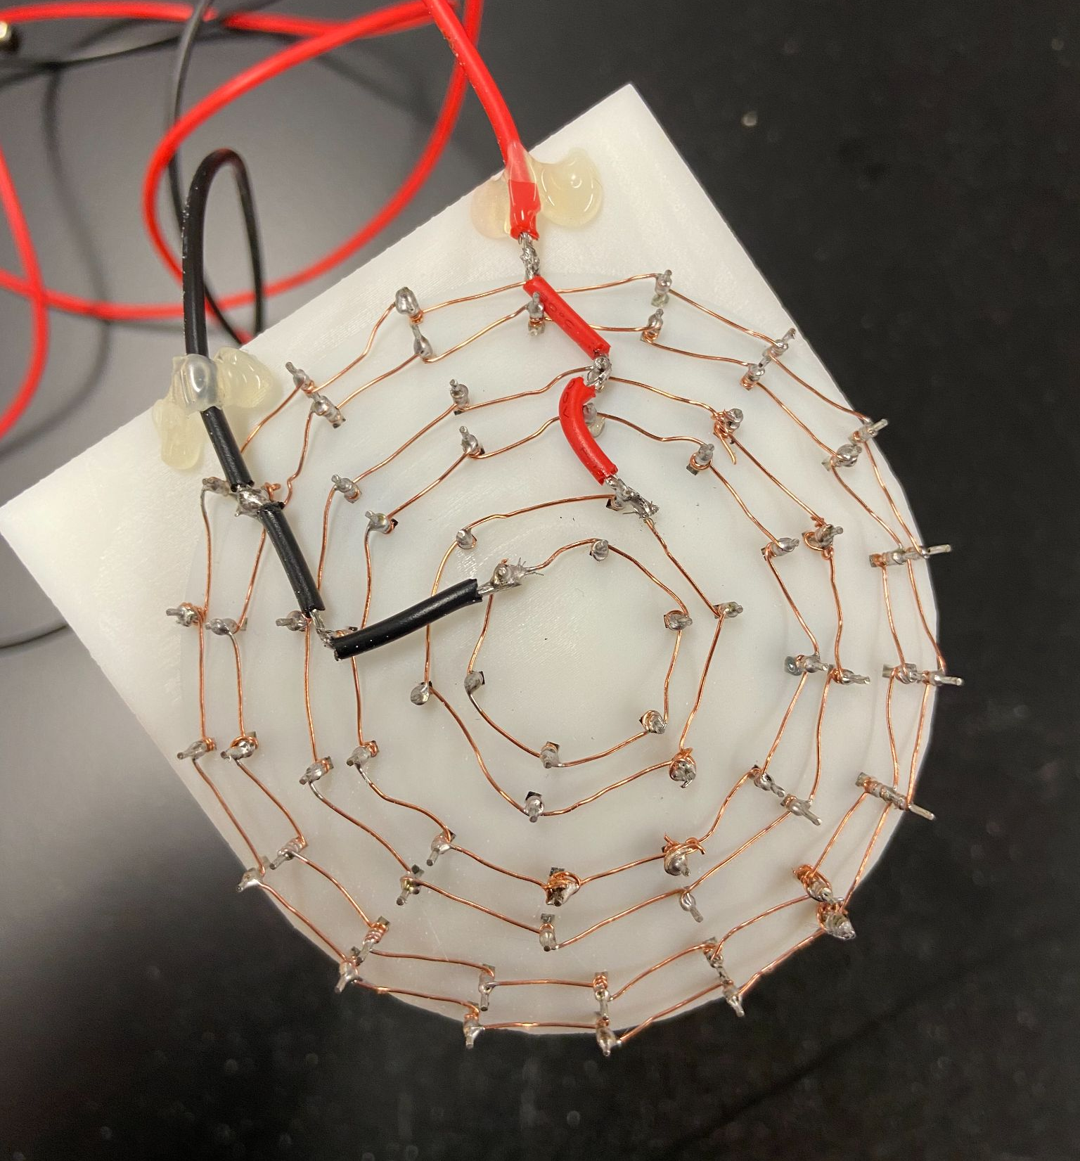
Construction
Acoustic Levitator. UpnaLab. Instructables. August 14, 2017. https://www.instructables.com/Acoustic-Levitator/

Slide 21
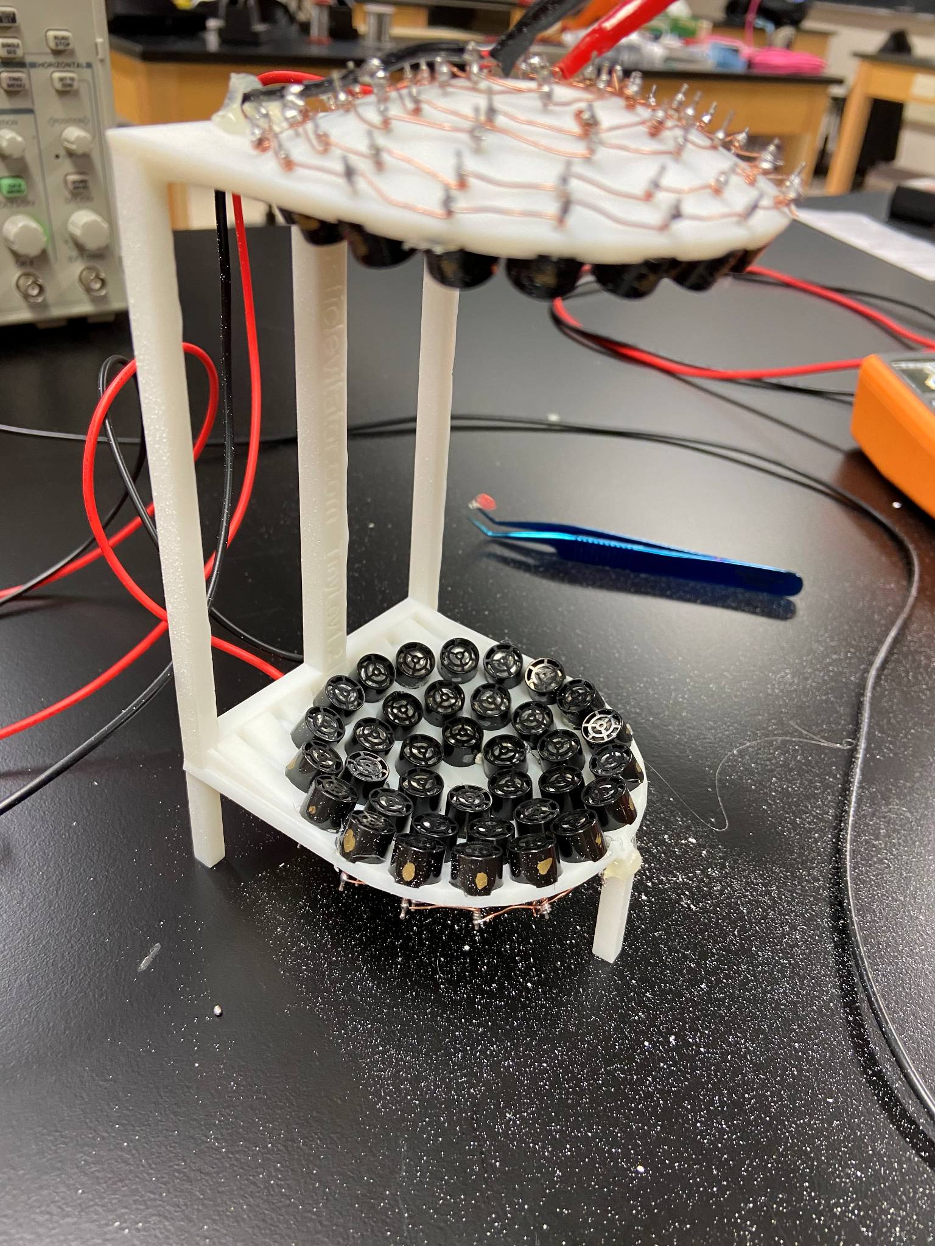
Completed Construction

Slide 22
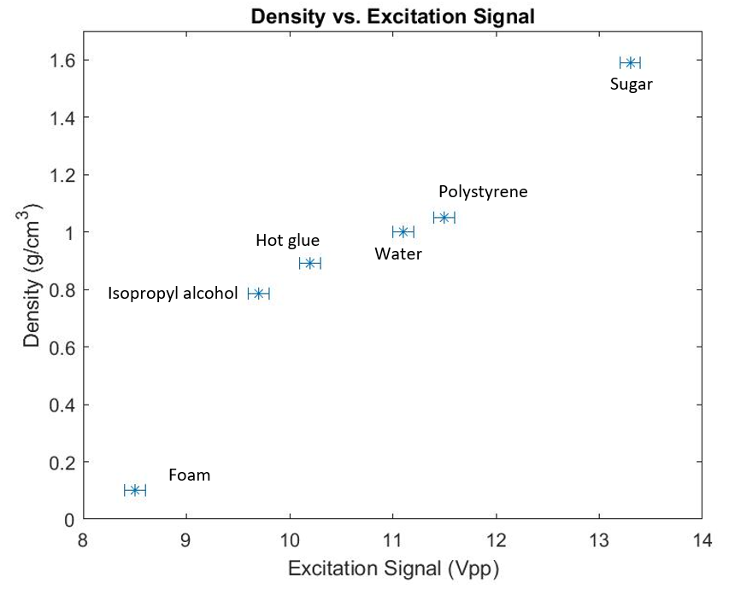
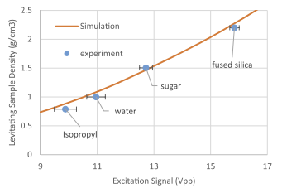
Experimental Results
Materials that could not be levitated:
Copper
8.96 g/cm³
Solder
8.6 g/cm³
TinyLev: A multi-emitter single-axis acoustic levitator (Additional Resources). Asier Marzo, August 10, 2017. https://aip.scitation.org/doi/pdf/10.1063/1.4989995
References for density:
https://en.wikipedia.org/wiki/Copper
https://www.usgs.gov/special-topic/water-science-school/science/water-density?qt-science_center_objects=0#qt-science_center_objects
https://en.wikipedia.org/wiki/Polystyrene
https://multimedia.3m.com/mws/media/639684O/3m-scotch-weld-hot-melt-3781b-and-3784b-flyer.pdf
https://en.wikipedia.org/wiki/Isopropyl_alcohol
http://www.matweb.com/search/datasheet_print.aspx?matguid=06a31d97bb734b509043d81cf131b280

Slide 23
Theory results
Did not get to finish theory script
We did get values for everything we needed, but not correct values
Troubleshooting
Geometry calculations
Pressure calculation
MATLAB debugging
What would be next
Keep troubleshooting script
Compare experimental results with theory
Find maximum specific weight of an object that can be levitated

Slide 24
Pros and Cons of setup
Pros:
Low cost
Easy to assemble
Works without much overhead - prepackaged
Cons:
Hard to control voltage (have to edit code)
Levitation “pocket” very small
Size of particles that can be levitated are small
Cannot levitate very dense objects

Slide 25
What we would do differently
Explore MATLAB models sooner
Use better time management
Prioritize details to explore (transducer testing, coordinate system details, etc.)
Utilize Dr.Flater, Dr.Marzo, other experts as a resource more (quick idea bounce)

Slide 26
Challenges and lessons learned
Challenges
Soldering the thin wires that connect transducers carefully
Concepts and math behind MATLAB script (programming like a MATLAB coder using vectors, calculating theta generally, etc.)
Testing samples - scale of samples
Lessons learned
Pseudo code and get concepts down before writing code
Check connections as you go

Slide 27
Summary
Goal: To determine what is the largest specific weight of an object of set volume that can be levitated?
Standing wave and acoustic levitation review
Determining the force using the complex pressure and Gork’ov potential
How we wrote a MATLAB script to model levitation
Testing our assumption about the transducers
Levitator construction
Results
Challenge with transducers, mathematics, and soldering

Slide 28
Questions?

